Slide 1
Lecture # 1 Introduction to Computer Programming CS161
Basic Computing Concepts
Department of Computer Sciences Air University Multan Campus

Slide 2
Today’s Topics
Computers, What are Computers?
How a Computer Works?
Computer Sciences
Computer Hardware → Types
Basic Input / Output Devices
Storage Devices
CPU & Its Parts
Computer Software → Types
Types of Computers
Today’s Computing
Summary

Slide 3
What is a Computer?
According to Bradford public Library
“Computers are not very intelligent devices, but they handle instructions flawlessly and fast. They must follow explicit directions from both the user and computer programmer. Computers are really nothing more than a very powerful calculator with some great accessories. Applications like word processing and games are just a very complex math problem”

Slide 4
Contd..
“A computer is a programmable machine designed to sequentially and automatically carry out a sequence of arithmetic or logical operations”.
“Computers do perform a specific task as per user instructions, they take input, process it, analyze it give you out put as per desire. To perform a basic operation they use, input / output/, memory, processing devices”.

Slide 5
Contd..
A computer is an electronic machine which can perform multiple tasks with the help of computer program i.e. enhancing the efficiency of the system. A computer’s efficiency can be enhanced with the help of software and hardware.

Slide 6
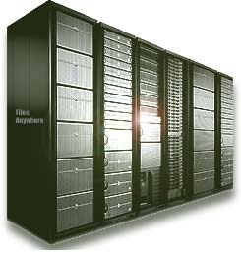
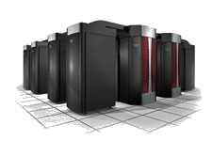
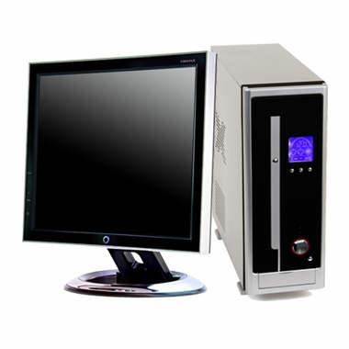
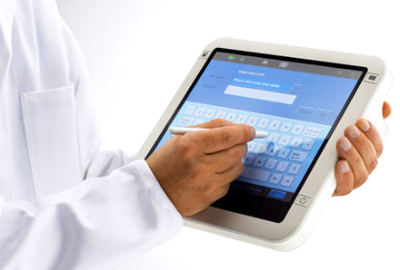
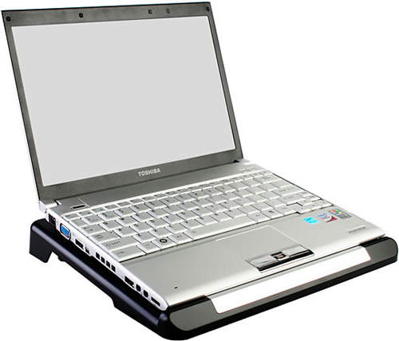
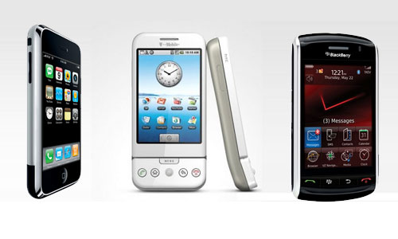
Computers
Large Servers
Personal Computers / Workstations
Supercomputer

Slide 7
What is Computer Science then?
Computer Science is the study of computers and computational systems. Unlike electrical and computer engineers, computer scientists deal mostly with software and software systems; this includes their theory, design, development, and application.

Slide 8
Data & Information
Data is a collection of unprocessed items, text, numbers, images, audio, video etc.
Lets say we have data like: Akmal, BSCS – FALL 2011, student, Air University
Information: Anything that is processed or organized or in other words Processed data is called Information. Data that has some menainingful representation is called information.
Example: Akmal is a BSCS-FALL 2011 student at Air University Multan.
Computer processes the Raw Data into Information

Slide 9
CHARACTERISTICS OF COMPUTER
Speed
Accuracy
Power to Remember
Diligence
No IQ
No Feeling
Storage

Slide 10
What is computer Science?
Computer science or computing science (abbreviated CS) is the study of the theoretical foundations of information and computation and of practical techniques for their implementation and application in computer systems. Computer scientists invent algorithmic processes that create, describe, and transform information and formulate suitable abstractions to model complex systems.

Slide 11
Computer Hardware & Software

Slide 12
Computer Hardware
In order to interact with computers we have to use some sort of Hardware Devices. There are different types of Hardware Devices which are used during a specific task to perform. Tangible parts of a computer system are Hardware.
Main Hardware Types are:
Input Devices
Output Devices
Storage Devices
Processing Devices

Slide 13
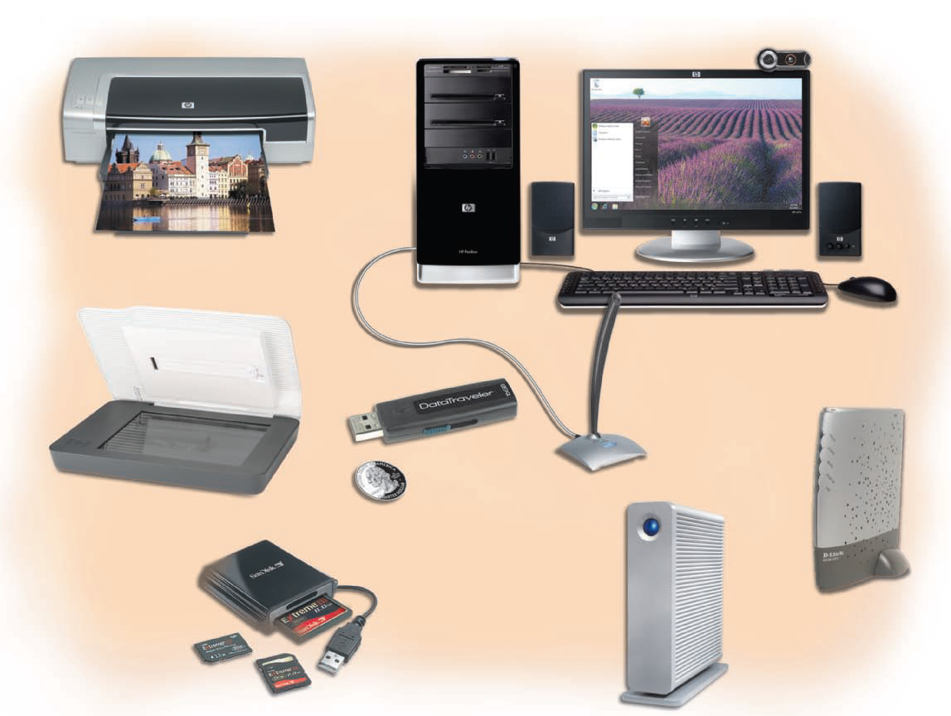

Slide 14
Computer Hardware & Software

Slide 15
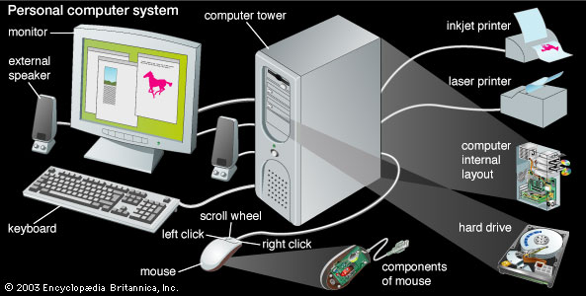
Main Hardware of a Computer

Slide 16
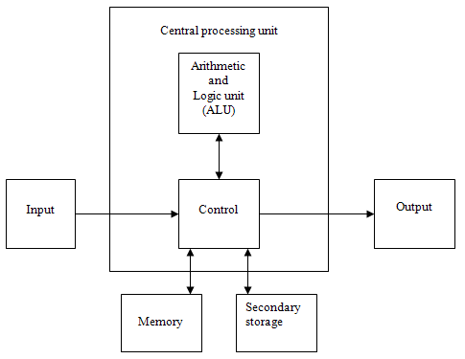
Basic Hardware of a Computer System

Slide 17
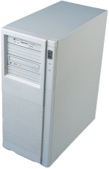

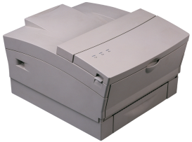
Computer Components
Input
Process
Output
seconds - milliseconds
nanoseconds
seconds - milliseconds
• Keyboard
• Mouse
• Optical scanner
• Voice input
• Bar code
• Touch screen
• Light pen
• MICR
• Magnetic strips
• Card reader
• Other computers
• Processor
• RAM
• Device controllers
• Video monitor
• Printer
• Plotter
• Process control
• Voice output
• Music synthesizers
• Other computers
Secondary
storage
milliseconds
• Magnetic Disk
• Floppy Disk
• Optical Disk
• Tape Drive
• USB Drive

Slide 18
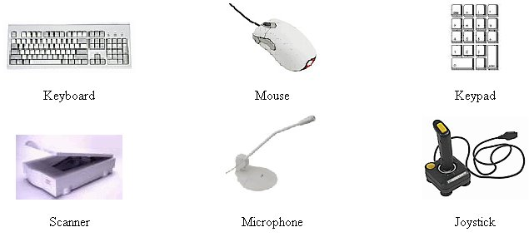
Input Devices
input device is any peripheral (piece of computer hardware equipment) used to provide data and control signals to an information processing system such as a computer or other information.

Slide 19
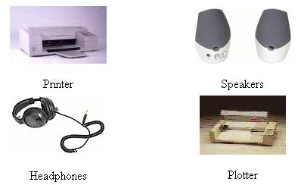
Output Devices
An output device is any piece of computer hardware equipment used to communicate the results of data processing carried out by an information processing system (such as a computer) to the outside world.

Slide 20
Storage Devices
There are mainly two types of storage devices:
Internal Storage Devices
External Storage Devices

Slide 21
Internal Memory Devices
Internal Memory mainly consists of:
RAM & ROM
Cache Memory
Registers

Slide 22
Internal Memory Devices
ROM = Read-Only Memory
Stores information permanently (non-volatile)
Used to store the information required to startup the computer
Many types: ROM, EPROM, EEPROM, and FLASH
FLASH memory can be erased electrically in blocks
RAM = Random Access Memory
Volatile memory: data is lost when device is powered off
Dynamic RAM (DRAM)
Inexpensive, used for main memory, must be refreshed constantly
Static RAM (SRAM)
Expensive, used for cache memory, faster access, no refresh
Video RAM (VRAM)
Dual ported: read port to refresh the display, write port for updates

Slide 23
Registers
High speed storage areas within the CPU
Directly linked to the CU and ALU
Much faster access than memory access
Instructions using only registers execute more efficiently than those having memory operands

Slide 24
Memory Hierarchy
Registers
Fastest storage elements, stores most frequently used data
General-purpose registers: accessible to the programmer
Special-purpose registers: used internally by the microprocessor
Cache Memory
Fast SRAM (Static RAM) that stores recently used instructions and data
Recent processors have 2 levels
Main Memory (DRAM)
Disk Storage
Permanent magnetic
storage for files
registers
cache memory
higher speed, smaller size
lower cost per byte
main memory
disk storage

Slide 25
Secondary Storage Devices
These are devices for storing the data permanently on the computer:
Hard Disks
Magnetic Tapes
USB Enabled Devices
DVD ROMS
CDs

Slide 26
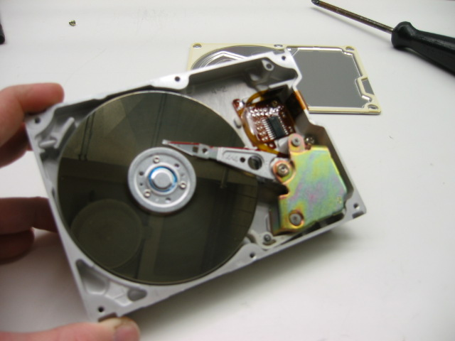
Magnetic Disk Storage
Disk Access Time =
Seek Time +
Rotation Latency +
Transfer Time
Sector
Read/write head
Actuator
Recording area
Seek Time: head movement to the desired track (milliseconds)
Rotation Latency: disk rotation until desired sector arrives under the head
Transfer Time: to transfer one sector
Track 2
Track 1
Track 0
Arm
Direction of rotation
Platter
Spindle

Slide 27
Secondary Storage Devices Table
Drive | Capacity (gigabytes) | Speed (Write MB/s) | Initial Cost (dollars) | Cost/GB (dollars)
Magnetic hard | 80 – 1,000 and more | 30 – 50 | 65 – 500+ | 0.28
USB drive | 0.5 - 50 | 4 – 8 | 40 – 200 | 10
Tape | 250 – 2,000 | 2 – 20 | 300 – 5,000+ | 0.50 – 1.00
CD-ROM | 0.70 | 2 – 5 | 50 | 0.42
DVD | 4.77 (8.5 DL) | 2 – 5 | 50 – 100 | 0.11
Blu-Ray | 25 (50 DL) | 2 – 5 | 700 | 0.72

Slide 28
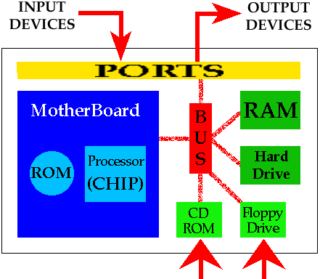
How a computer Works?

Slide 29
Basic Computer Organization
Since the 1940's, computers have 3 classic components:
Processor, also called the CPU (Central Processing Unit)
Memory and Storage Devices
I/O Devices
Interconnected with one or more buses
Bus consists of
Data Bus
Address Bus
Control Bus
data bus
registers
Processor
(CPU)
Memory
I/O
I/O
Device
Device
#1
#2
ALU
CU
clock
control bus
address bus

Slide 30
Motherboard
CPU socket
External cache memory slots
For high speed cache memory that is used by CPU to reduce its access to slower conventional RAM
Main memory slots
Memory chips are on small boards that plug into available memory slots
BIOS chips
Sound synthesizer chip (optional)
Video controller chip (optional)
IDE cable connectors (IDE = Integrated Drive Electronics)
For internal fixed disks and CD ROM drives
Parallel, serial, USB, video, keyboard, joystick, network, and mouse connectors
PCI bus connectors
Notes:
BIOS
The BIOS software is built into the PC, and is the first code run by a PC when powered on ('boot firmware'). The primary function of the BIOS is to load and start an operating system. When the PC starts up, the first job for the BIOS is to initialize and identify system devices such as the video display card, keyboard and mouse, hard disk, CD/DVD drive and other hardware. The BIOS then locates software held on a peripheral device (designated as a 'boot device'), such as a hard disk or a CD, and loads and executes that software, giving it control of the PC This process is known as booting, or booting up, which is short for bootstrapping.

Slide 31
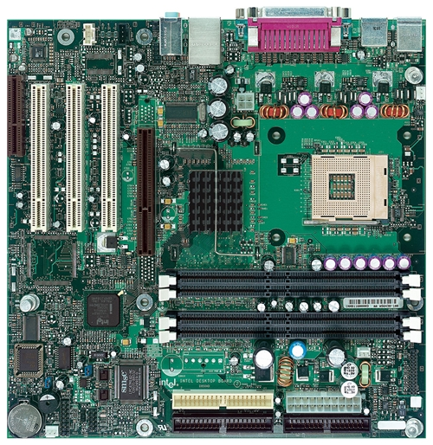
Intel D850MD Motherboard
mouse, keyboard, parallel, serial, and USB connectors
Video
Audio chip
PCI slots
memory controller hub
Pentium 4 socket
AGP slot
dynamic RAM
Firmware hub
I/O Controller
Speaker
Power connector
Battery
Diskette connector
Source: Intel® Desktop Board D850MD/D850MV Technical Product Specification
IDE drive connectors

Slide 32
Instruction Execution Cycle
Fetch
CU fetches the instruction, copying it from memory to the CPU and increments the Program Counter
Decode
CU determines the type of the instruction to be executed, passes zero or more arguments to the ALU and sends signals to the ALU to indicate the type of operation
Fetch operands
If a memory operand is used, CU initiates a read operation to retrieve the input operand from memory
Execute
ALU executes the instruction, sends data to the output operand and updates status flags providing information about the output
Store output operand
If output operand is in memory, CU initiates a write operation to store the data

Slide 33
Instruction Execution Cycle

Slide 34
Memory
Ordered sequence of bytes
The sequence number is called the memory address
Byte addressable memory
Each byte has a unique address
Supported by almost all processors
Physical address space
Determined by the address bus width
Pentium has a 32-bit address bus
Physical address space = 4GB = 2³² bytes
Itanium with a 64-bit address bus can support
Up to 2⁶⁴ bytes of physical address space
Notes:
Main Memory = RAM (Random Access Memory) = Primary Memory is
direct access memory i.e., an element of data or instruction can be directly stored/accessed by selecting and using any locations on the storage media.
temporary (volatile) - requires power to maintain the stored information

Slide 35
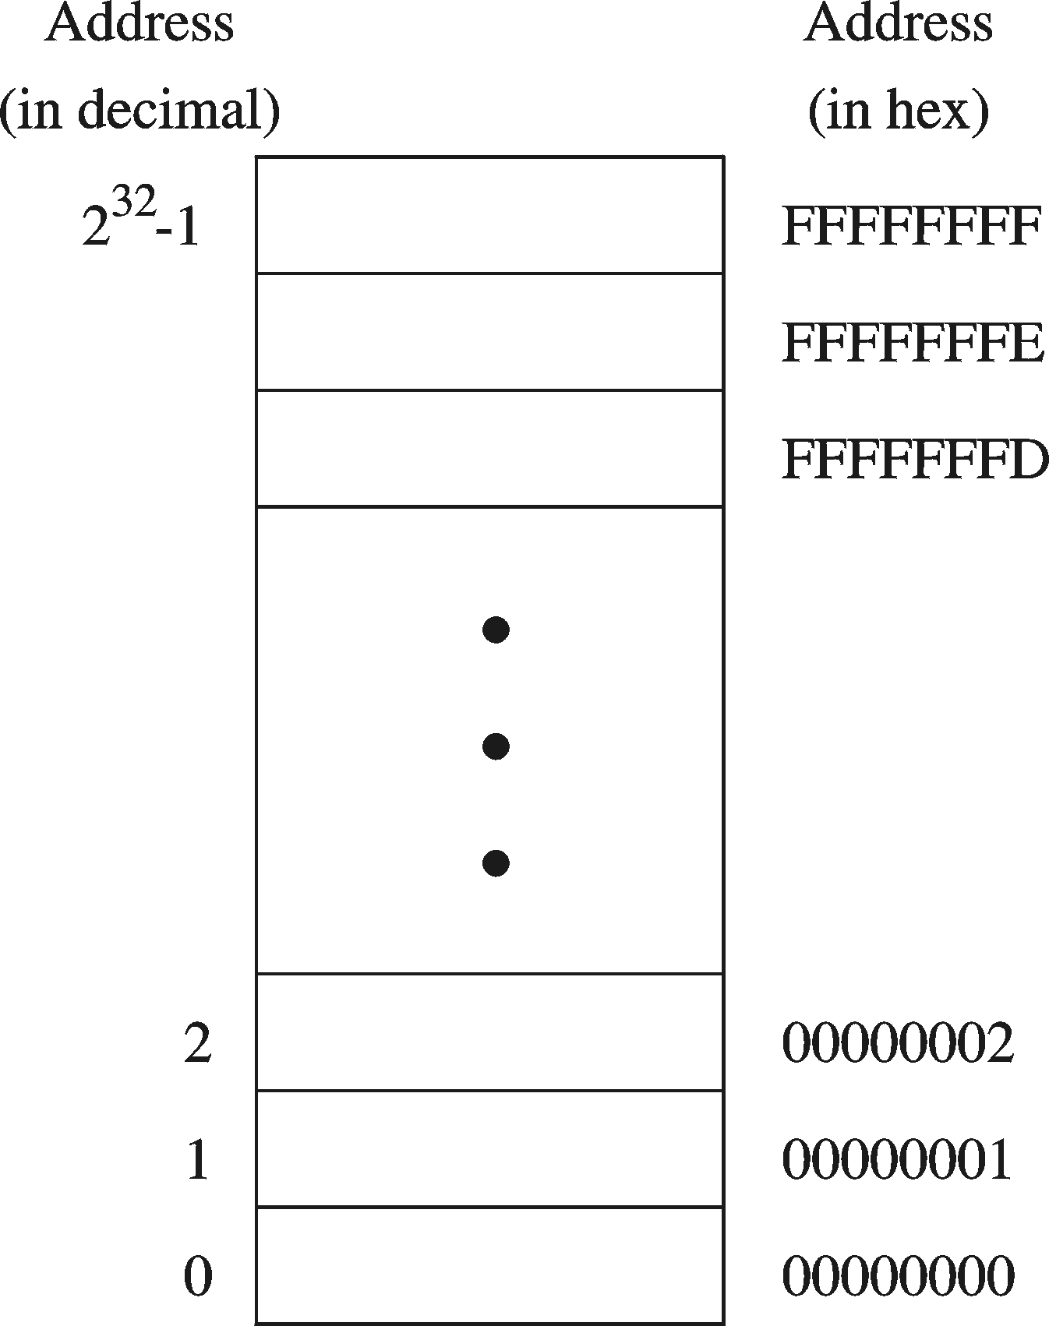
Address Space
Address Space is the set of memory locations (bytes) that can be addressed

Slide 36
What are two designs used for the CPU?
• CISC (complex instruction set computing)
o Supports large number of instructions
o CPU executes complex instructions more quickly
• RISC (reduced instruction set computing)
o Supports smaller number of instructions
o CPU executes simple instructions more quickly

Slide 37
Computer Software
A software is a set of instructions in the form of a program which tells the computer to perform a specific task.
Example: Video Player, Digital Calculator, Alarm System etc.
Software Types
System Software
Application Software
Language Software
Utility Software

Slide 38
The Internet

Slide 39
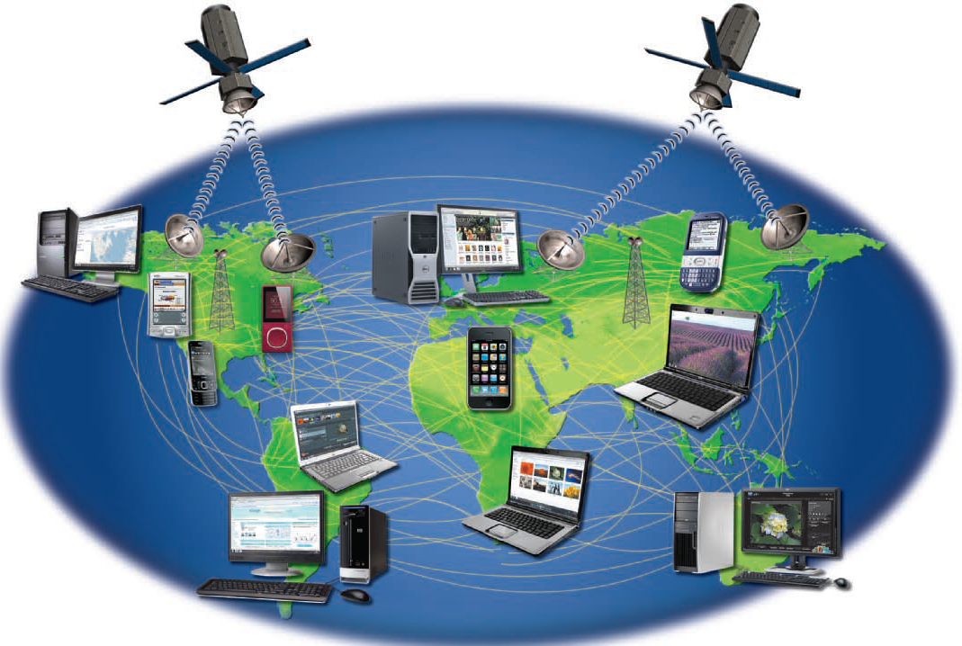
The Internet

Slide 40
Software Types
Operating System
Utilities
Programming Languages and Tools
Application
General purpose examples
Word processing
Spreadsheets
Graphics
Single purpose examples
Accounting
Tax preparation
Games
CAD-CAM
Database Management Systems (DBMS)

Slide 41
Application Software
Information Storage: DBMS
Analysis: Calculations (spreadsheets and more)
Communication: Writing (word processors and more)
Communication: Presentation and Graphics
Communication: Voice and Mail (e-mail and more)
Organizing Resources: Calendars and Schedules
There are many other Types of Application Software which are being used for different purposes. Everyday Hundreds of Application Software are built all over the world.

Slide 42
Types of Computers
1.Microcomputer: Microcomputer is at the lowest end of the computer range in terms of speed and storage
capacity. Its CPU is a microprocessor. The first microcomputers were built of 8-bit microprocessor chips. The most common application of personal computers (PC) is in this category. The PC supports a number of input and output devices. An improvement of 8-bit chip is 16-bit and 32-bit chips. Examples of microcomputer are IBM PC, PC-AT, DELL, HP .
2. Mini Computer: This is designed to support more than one user at a time. It possesses large storage
capacity and operates at a higher speed. The mini computer is used in multi-user system in which various
users can work at the same time. This type of computer is generally used for processing large volume of data in an organization. They are also used as servers in Local Area Networks (LAN).
3. Mainframes: These types of computers are generally 32-bit microprocessors. They operate at very high speed, have very large storage capacity and can handle the work load of many users. They are generally used in centralized databases. They are also used as controlling nodes in Wide Area Networks (WAN). Example of mainframes are DEC, ICL and IBM 3000 series.
4. Supercomputer: They are the fastest and most expensive machines. They have high processing speed
compared to other computers. They have also multiprocessing technique. One of the ways in which
supercomputers are built is by interconnecting hundreds of microprocessors. Supercomputers are mainly
being used for whether forecasting, biomedical research, remote sensing, aircraft design and other areas of
science and technology. Examples of supercomputers are CRAY YMP, CRAY2, NEC SX-3, CRAY XMP and PARAM from India.

Slide 43
Today’s Computing
Emerging Technologies are changing Everything in Computing. Computing is being redefined.
Web Based Computing
Cloud Computing
Mobile Computing
Embedded Computing
Surface Computing

Slide 44
Lets Summarize

Slide 45
Take Home Task
Home Work1: Types of Computers Today
Make a brief Report: Use internet and search for the latest types of Computers ranging from Server Machines, Super Computers, Personal Computers, Laptops, Tablets, and Smart Phones / Mobiles and do the following:
Make 2 Tables one for PCs and 1 for Lap Tops. Give Following Information:
Personal Computer Table
Laptop Table
Processor Speed | Cache | System Bus Speed | RAM | Hard disk Space | Display | Vendor
Processor Speed | Cache | System Bus Speed | RAM | Hardisk Space | Display | Battery Timings | Vendor

Slide 46
Go through Time lines of Computers
Given at the end of the Chapter .

Slide 47
References
http://www.bedford.lib.nh.us/Basics.htm
http://en.wikipedia.org/wiki/Computer
http://www.lautech.edu.ng/Academics/pre-degree/material
Book: Discovery Computers: 2012/2010 Shelly Vermaat (Photo copy is available)

